Slide 1

Team Intro
Project Group Members:
1. Fenteng Michael - 11210750
2. Samuel Akpah - 11125009
3. ⁠Ryan Brown- 11357610
4. Wisdom Nana-Abena Ogbonna – 11288300
5. ⁠Michel Kpodo - 11012578
6. Ransford Larbi - 10681368
7. ⁠Adams Emmanuel Paddy - 11264136
Notes:
RYAN

Slide 2
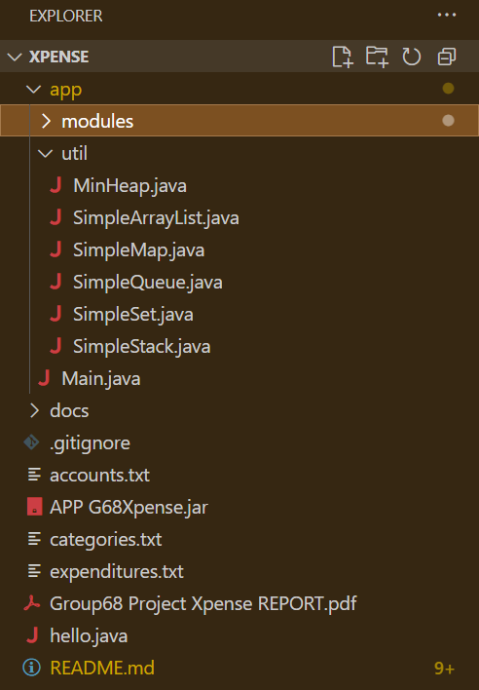
About Project
The goal of this project is to simulate a digital expenditure tracking and financial management system that mimics an accountant’s workflow. It allows for:
• Recording and categorizing expenditures
• Managing bank accounts and balances
• Generating analytics reports
• Raising alerts for critical financial events
• All while ensuring it works offline-first with no cloud or network dependencies.
Notes:
RYAN

Slide 3
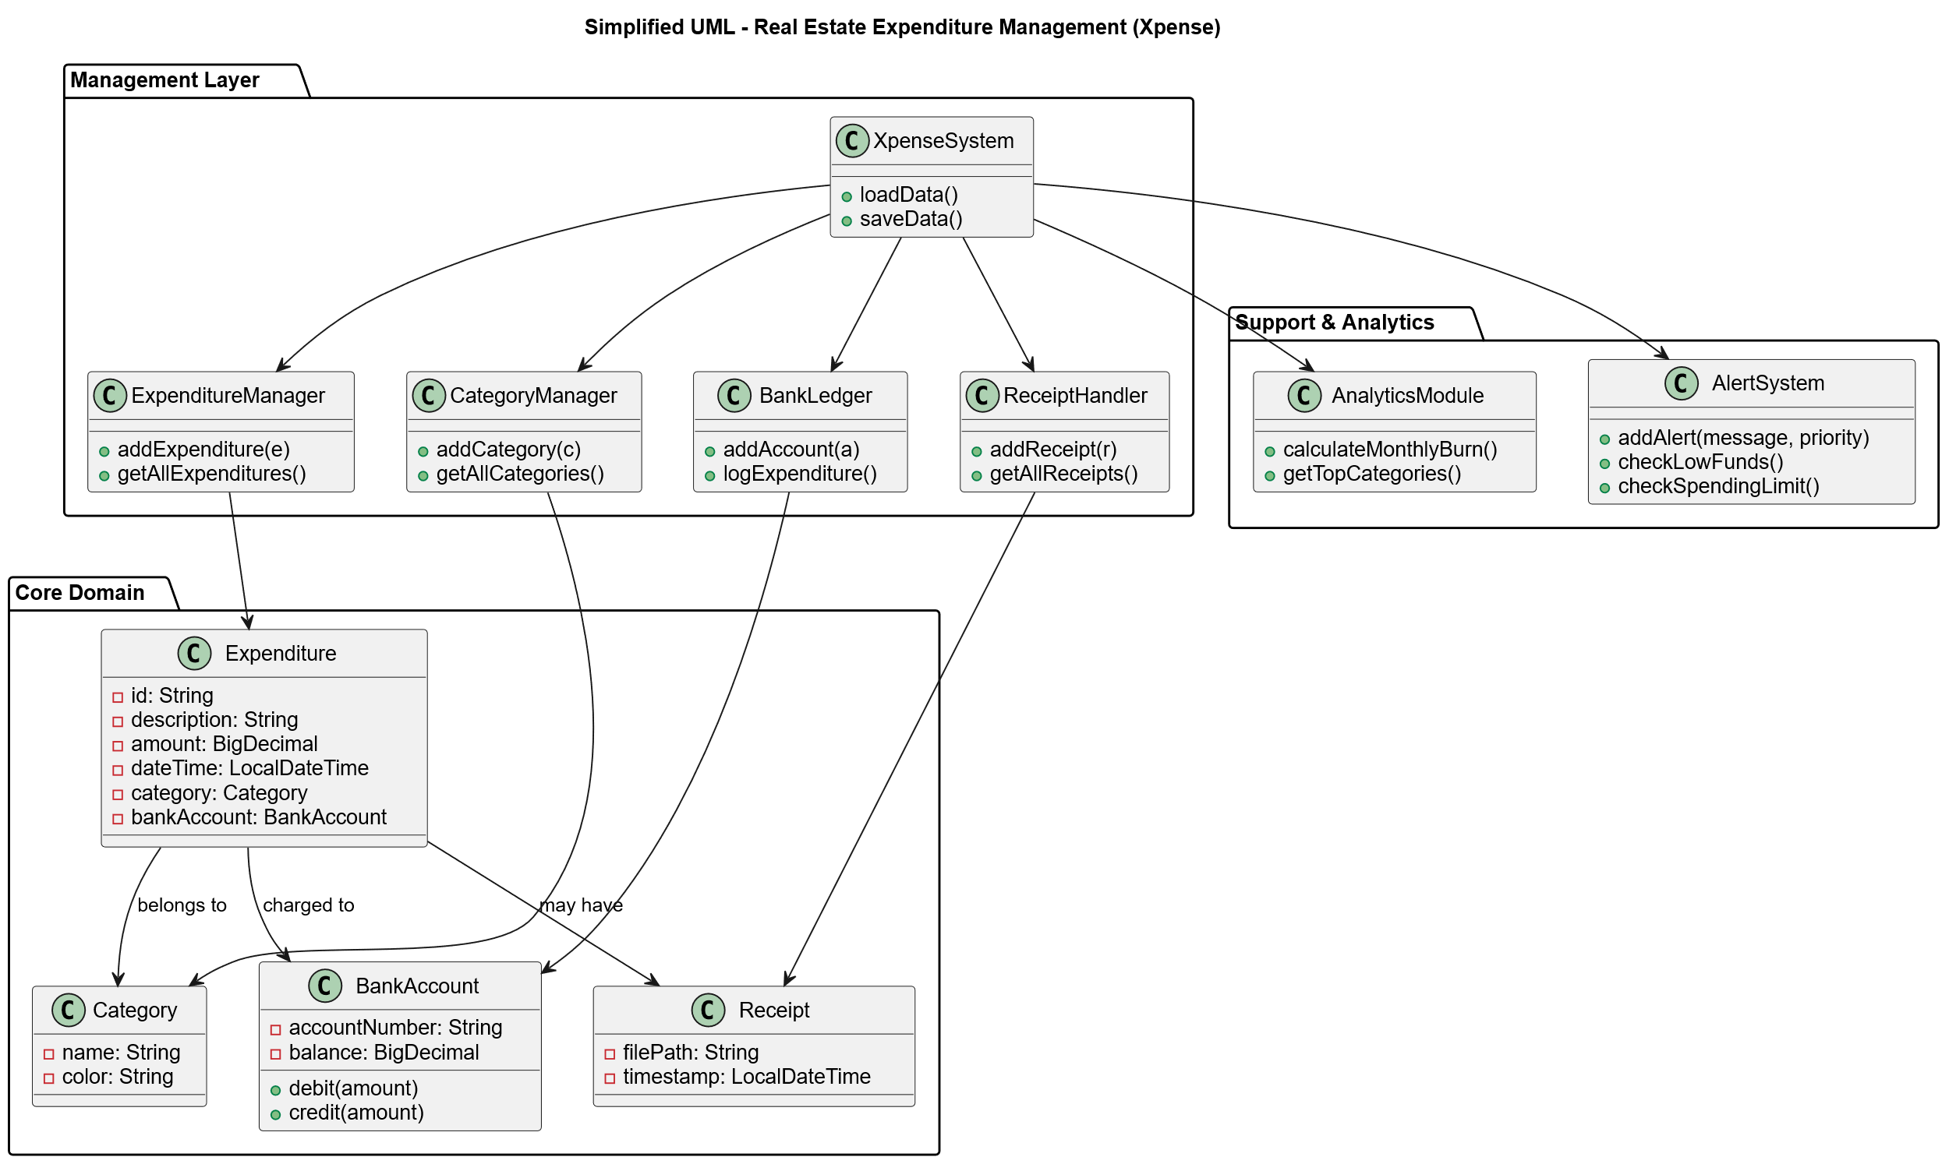

UML (Class Diagrams)
Notes:
WISDOM

Slide 4
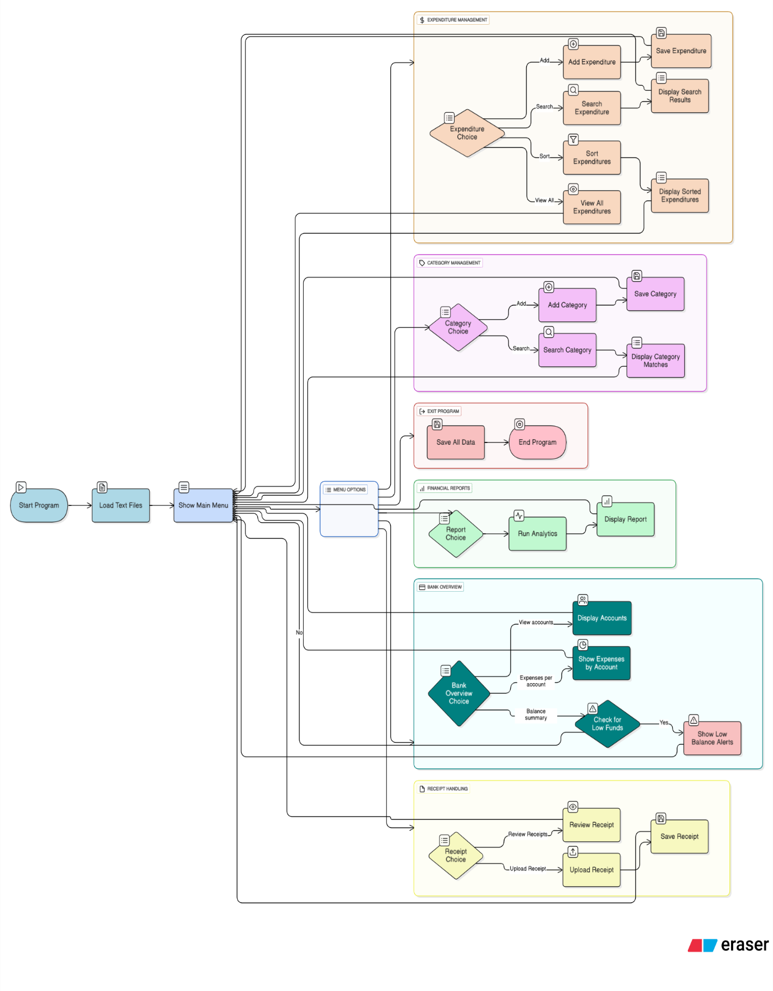
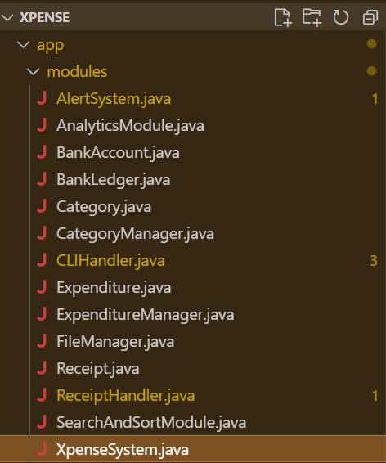
Program Flow
Notes:
WISDOM

Slide 5
SimpleSet
Implemented in CategoryManager class to store unique category names.
Complexities:
Add: Ω(1) average, O(n) (if linear search)
Search: O(n) , Ω(1)
Notes:
Why Chosen:
Ensures no duplicate categories, mimicking how accountants organize distinct ledgers.
Likely implemented using a hash-based or linear structure.
PRADO

Slide 6
SimpleMap
CategoryManager Purpose: Maps category names to their expenditure lists.
Complexities:
Put: O(1) average, O(n) worst
Get: O(n) worst, Ω(1) best
Traversal: O(n)
Notes:
Why Chosen:
Enables fast lookup and association of expenditures with categories.
Simulates ledger-style mapping.

Slide 7
ArrayList
Implemented in BankLedger for maintaining global transaction history.
Implemented in FileManger to temporily stores loaded objects
Implemented in BankAccount to track expenditures per account.
Complexities:
Add: Amortized O(1)
Get: O(1)
Remove: O(n) worst (due to shifting)
Notes:
Why Chosen:
Preserves insertion order.
Supports sequential access and iteration.
Dynamic resizing
MICHAEL

Slide 8
Simple Queue
Implemented in ReceiptHandler for FIFO receipt processing
Complexities:
Insert: O(log n)
Peek/Remove: O(log n)
Notes:
Why Chosen:
Efficient for retrieving highest or lowest spending categories.
Mimics accountant prioritization.
PADDY

Slide 9
MinHeap(custom priority)
Implemented in the AlertSystem Purpose to manage alerts by priority.
Complexities:
Insert: O(log n)
Extract Min: O(log n)
Peek: O(1)
Notes:
Why Chosen:
Ensures urgent alerts are surfaced first.
Efficient for dynamic alert handling.
RANSFORD

Slide 10
Simple Stack
Implemented in ReceiptHandler, used to store processed receipt.
Complexities:
Push: O(1)
Pop: 0(1)
Peek/Remove: O(1)
Notes:
Why Used
The stack is used here to implement an undo/redo functionality for receipt processing, where the most recently processed receipt can be quickly accessed and reverted back to the processing queue. This LIFO (Last In, First Out) behavior is perfect for tracking recent operations and providing users the ability to undo their last processing action, which is a common requirement in business workflow applications.
WISDOM

Slide 11
LIVE DEMO

